Slide 1
SWAN Material shortage 8D report
Prepared By: KT/Hop Nguyen
Reviewed By: Ben Trinh
Tony Tu / Ken
Date: 2023-12-04

Slide 2
D1
Establish the Team
Team Leader
Team Member
Sales: Miya Wang
PM: An Tran
PQE: Toney Tu, Ken
PE : Jack Han
Kitting: Hop Nguyen
ME: Cheng Lun
  Operation leader: David Yin
  QA leader: CB Lin
Notes:
MA5800-X7#display cable modem <MAC> detail

Slide 3
D2
Description the Problem
Issue Description (5W2H)
When | 2023-11-18
Who | Fii’s issue (KITTING & MPM)
Where | Fii production line
What | The latest MO release, Material is shortage →shipping plan was impacted
Why | production line NG quantity was 79pcs/incoming material shortage*303pcs
How | Material PN: 377.00403.005LT CABLE INT HARNESS WIRE stock should be 382PCS but actually no cables in stock.
How many | Material PN: 377.00403.005LT*382PCS

Slide 4
D3
Containment Action
Immediately meeting with CFT team to find out the root causes and take out solution.
Done on 18th Nov (Owner: KT: Hop Nguyen /PC: Sara Le/ PM: An Tran, PD: Wen Yong)
Report to customer to help prepare material to cover this quantity.
Done on 23th Nov (Owner: PM: An Tran/ MPM: Zenda Nguyen)
Notes:
5.26891E-07 4.96855E-07

Slide 5
D4
Root Cause Analysis
Risk
Review work process: 377.00403.005LT CABLE INT HARNESS WIRE
Normal
WH receive materials from vendor
KT receive from WH
KT release material to production line
Production line online
MO settlement
IQC inspection
MO offline
The incoming materials are in full boxes, the quantity is confirmed according to the outside box label.
The incoming materials aren’t full boxes, the materials will be counted quantity 100%.
Random inspection based on proportion
The incoming materials are in full boxes, the quantity is confirmed according to the outside box label.
The incoming materials aren’t full boxes, the materials will be counted quantity 100%.
The incoming materials are in full boxes, it will be released to production line as full boxes.
The incoming materials aren’t in full boxes, KT and production line will count 100%.
The production line receives the materials and produces them directly.
NG materials in production line can not handle in time. (NG materials handling process: NG materials are found in the production line, →notify to ME/SQE for confirmation → returned to MRB for scrap)
For continuous production of MO, inventory and consumption is calculated based on the last MO.
Kitting balanced material when MO offline not find out material damaged in standard. MO closed
If there is short packaging of incoming materials, WH can’t detect it in time and send them to KT directly
KT receive materials according to the full boxes and can’t detect short packaging of incoming materials.
KT release materials to production line by the full boxes and can’t detect short packaging of incoming materials.
SWAN Manufacture continuously, NG materials can’t handle in time.
MO manufacture continuously, so the shortage of materials will not be detected and handle in time.
Conclusion: 1. Short packaging of incoming materials can’t be detected.
2. Production line yield loss can’t be detected in time.
Notes:
5.26891E-07 4.96855E-07

Slide 6
Manage B&S materials’ quantities at WH&KT
1. Manage quantities at WH(Warehouse)
The incoming materials are in full boxes, the quantity is confirmed according to the outside box label.
The incoming materials aren’t full boxes, the materials will be counted quantity 100% .
WH check qty daily(full box is checked qty by label on the box, old qty will be counted 100%)
The materials countable will release to KT only enough qty follow WO(Work Order) demand and uncountable qty material will be released minimum packing qty
2. Manage quantities at KT(Kitting)
Materials are in full boxes, KT will release to production line as full boxes. Unfull boxes, KT and production line will count 100%. Materials countable will be released to the production line only enough qty follow WO(Work Order) demand and uncountable qty material will be released minimum packing qty.
The leave material will be returned if have when finish production.
KT use the system Distribution material to release material to the line and qty was deduct on time.

Slide 7
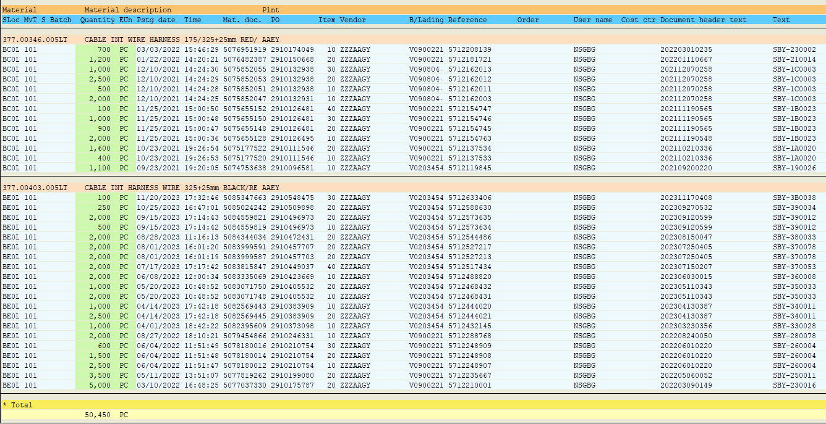
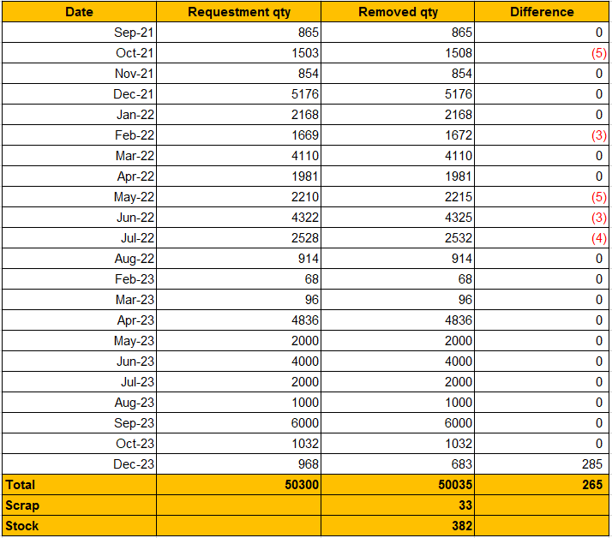
D4
Root Cause Analysis
Incoming materials record:
From Sep 2021 to Nov 2023, Incoming material quantity 50,450 pcs (107 boxes):
10 odd cartons*1950pcs(10 cartons, counted 100% no abnormal)
97 full cartons were not be counted 100% material inside so could detect material enough or not
II. Materials check out record:
From Sep 2021 to Nov 2023, material checked out quantity 50,035 pcs + scrap 33pcs, total 50068 pcs.
Base on the received and checked out quantities, stock should be 382pcs but actually no cables in stock.
III. MO manufacture continuously：
From 2021 to 2022, there is the record of production line loss, but there is no record in 2023.
23th Nov , 79pcs NG were found on the production line, the reason for 303pcs was not found, it was suspected that the incoming materials were short-packed.
Suspected that the incoming materials were short-packed *303pcs
IV. Root cause：
Production line yield loss were not detected in time.
Suspected that the incoming materials were short-packed.
Notes:
5.26891E-07 4.96855E-07

Slide 8

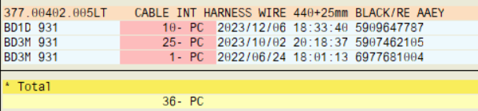
D4
Root Cause Analysis
The scrap history
377.00403.005LT CABLE INT HARNESS WIRE
II. 377.00402.005LT CABLE INT HARNESS WIRE
III. The scrap reason:
reason for being scrapped came from many reasons.
This quantities were accumulated before,
Some quantities are material NG(Function, cosmetic, etc) or operation errores…
These quantities were scrapped last year, we didn't save pictures or scrap report.
Notes:
5.26891E-07 4.96855E-07

Slide 9
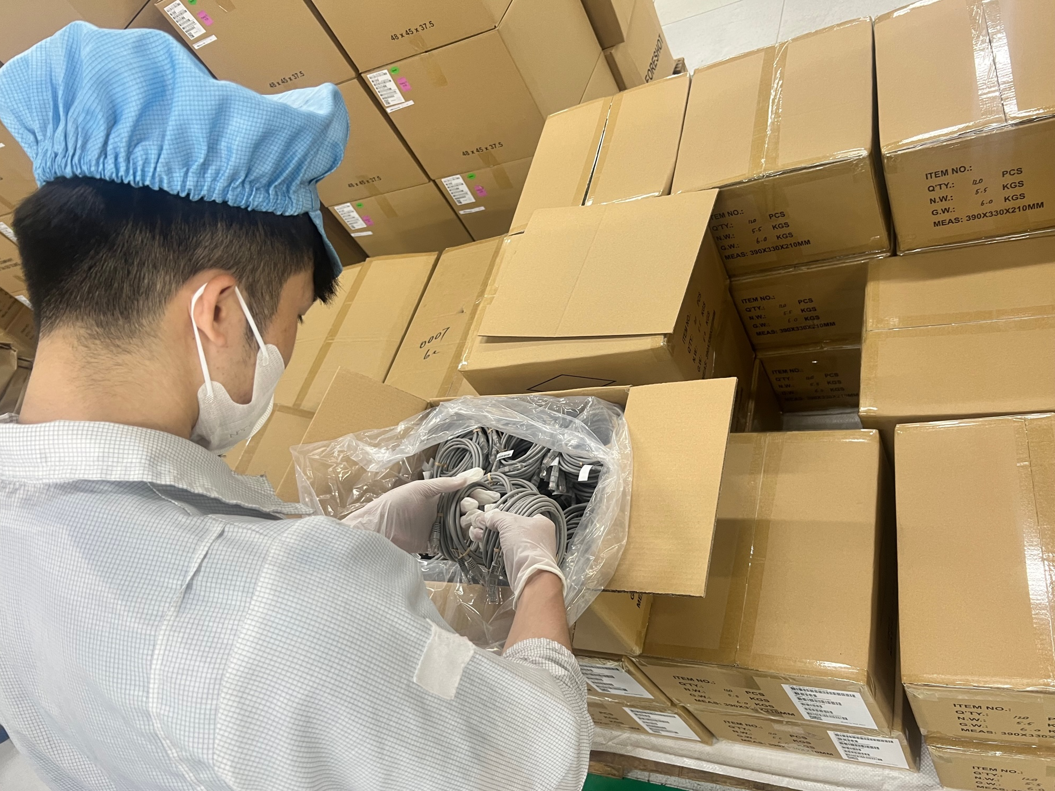

D5
Corrective Action
D6. Permanent improvement measures | Picture | Owner | Plan complete | Actual complete
For Buy & Sell materials, check the quantity of original packaging materials when receiving the materials. |  | Hop | 2023/11/19 | 2023/11/19
2. Use the material issuance system to deduct accounts in a timely manner and do inventory check daily for Buy & Sell materials. |  | Hop | 2023/11/19 | 2023/11/19
Receiving and counting materials
Distribution material system

Slide 10
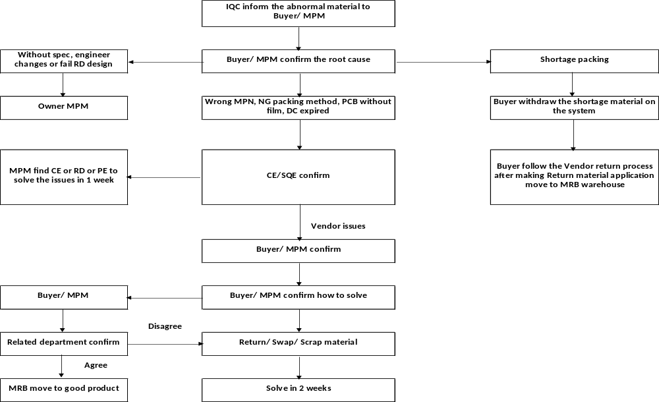
D5
The process in case of BS material abnormal shortage

Slide 11
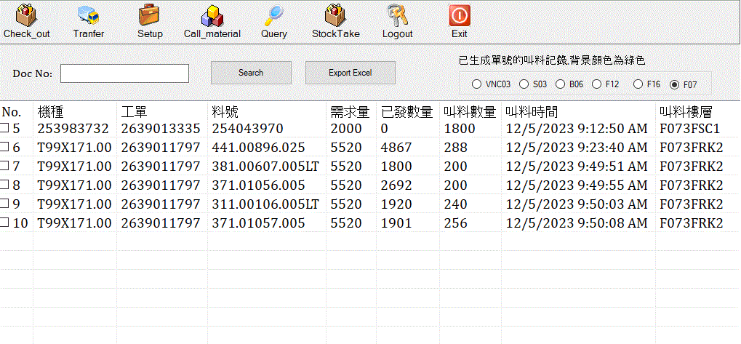
D6
Verification of Effectiveness
KITTING is doing 100% Q’ty inspection for B&S materials.
KITTING is using distribution material system and daily check inventory.
The effectiveness needs to be continuously monitored and improved.
D6: Verification of Effectiveness
Model
Work order
Material P/N
Req Qty
Check out Qty
Production line call material time
Line name
Production line call material Qty
Distribution material system

Slide 12
D7
Prevent Recurrence
All of countermeasures were implemented.
Owner : KT/Hop. Done on 11/30

